Slide 1
A Study on Data Visualization for Fishery Management
by Volodymyr Kozyr
B. Sc., Taras Schevchenko National University of Kyiv, 2017
School of Computing Science SIMON FRASER UNIVERSITY Fall 2021

Slide 2
Agenda
Introduction and main goals of the project
Related work
Problems and tasks identification
System overview
Data processing
Use cases implementation
Conclusions

Slide 3
Fishery Data Visualization
While visual representations can be used across a wide range of data sources, we are interested in how they can be used in the analysis of data associated with fisheries. Fishery data, like data from other domains, deals with observations across time, and across space. As such, many of the visualization techniques that have been applied to temporal or spatial data can be considered in our work. What is particularly interesting about fisheries data is that depending on decisions made after analysis it can lead to different economic and environmental consequences. Also, there are a large number of open data sources that we can draw upon.
This work will help people who are domain experts but are not very familiar with data analysis tools. The tool can help fishery management regulate fishery catching in certain Canadian provinces and help decide which policies or fishing quotas for specific fish types should be applied.

Slide 4
Related Work
There are different groups of users in the fishery domain like fishery management companies, environmental policy issuers and simple fishermen etc. All of them need to get different data and analyze it in some way. For example, marine environmentalists analyze data about the quantity of fish in a particular region, they issue quotas for fishery companies. After that companies analyze the fish stock market, plan, and distribute information to their employees (fishermen) in a way that it is optimized and profitable.
Papers discussed in this chapter are oriented primarily for fishery management, because papers for environmentalists, for example, include more information about biological and ecological perspectives rather than focusing on visualization methods. However, the content is complicated for readers who are not data analysts or/and experienced computer users.
So, the interest and primary goal of our work and research are in the design and use of tools that will be easily accessible for fishery management users as it needs to have more charts, visualizations, etc. than other groups. The tools need to support the decision-making process, so that appropriate conclusions can be made based on the available data.

Slide 5
Related Work
FishCAM2000 (FC) [4] is a computer-based integrated information system for fisheries management and marine environmental monitoring. It incorporates visualization of the fishery activity over the same spatial area of interest for a particular type of fish. It has a user-friendly and straightforward interface implemented in Windows Forms.
Figure 2.2.1. below shows the output after the user passes seven screens of settings of the query wizard. While entering so many screens of data may suggest a large amount of effort before one obtains any results, this process does allow the system to be as generic as possible but requires a great deal of effort and time from the user. One important advantage of the system is that it presents complex geodata, which includes the amount of fish caught in the geographical zone (polygon area shapes with latitudes and longitudes as data points) on the map instead of the data table, which is a considerable timesaving for users to understand the query output.

Slide 6
Related Work

Slide 7
Related Work
IDMVis [1]: is a visualization tool that shows multidimensional interrelated data during the day for patients with diabetes. IDMVis includes a novel technique for folding (splitting a sequence into periodic units like hours, days, etc.) and aligning records by events of interest and scaling the intermediate timeline. The designed tool helps doctors track the state of patients' important parameters and detect anomalies (Figure 2.3.2.). After that, doctors use it as a decision support tool for the treatment of diabetes.
Six clinicians evaluated design decisions positively, the criteria of the evaluation was how well proposed visualizations help with the decision-making process on daily basis (increasing of the decision-making speed). Also, that detailed visualization convinces doctors to prescribe were more personalized treatment for the patient.

Slide 8
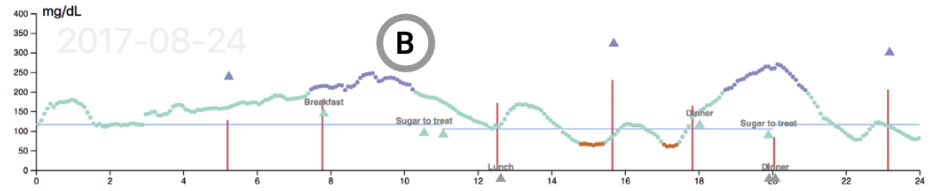
Related Work

Slide 9
Fishery Reports
The same approach of using line graph visualizations can be seen in a more recent annual environmental report on this kind of data. For example, Scottish Sea Fisheries Statistics [13] for 2019 from the Cabinet Secretary for Rural Economic and Tourism provides summary data and more detailed statistics by region.

Slide 10
Fishery Reports
From the information related to this topic, the following can be distinguished.
The total amount of fish caught (tonnage) is shown in blue, and the value of all landings by Scottish vessels is shown in red. By comparing the blue and red lines in Figure 3.1.3., the user can easily and quickly determine the connection (will be discussed in the following chapter) between the catch's value and the amount of fish caught in a specific year. For instance, the user can see that despite the tonnage falling since 2017, the value of landings remains constant.

Slide 11
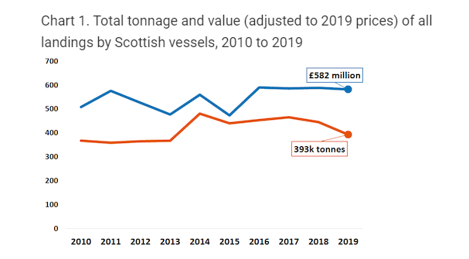
Fishery Reports

Slide 12
Fishery Reports
We can see that the marine industry requires to see overall reports on such parameters as “tonnage” and “value” (Figure 3.1.4.). From the pie charts, users can determine which type of fish gives which revenue according to tonnage.

Slide 13
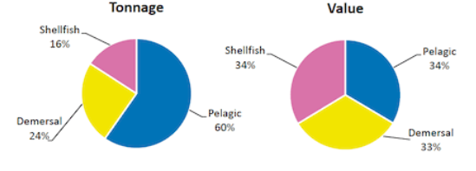
Fishery Reports

Slide 14
Fishery Reports
In the next report (Figure 3.1.5.) there are bar charts for two consecutive years presented. This is done mainly to see trends and then to decide if the fishery industry is doing better or worse than the previous year. After comparing values for two years some adjustments in fishery policies could potentially be implemented by ecologists or fishery companies.

Slide 15
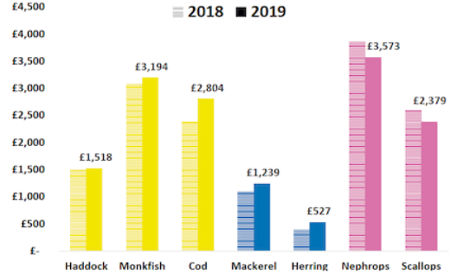
Fishery Reports

Slide 16
Fishery Domain Problems
Determining the optimal amount of catch for each type of fish to reduce environmental damage in a specific region
Predicting which species may also be subject to negative or positive effects (trends)
Establishing quotas (the proper amount of unloading of fish) which will minimize the negative impact on the environment
Analyzing the safety of methods for catching a particular type of fish in each region
And other…

Slide 17
Visualization Motivation
Analysis of the data presented in a table or text format may take significant amount of time , as was discussed in chapter 3.1. on IDMVis tool use cases. For example, it is hard to see trends, how values change through the years, as well as comparing data for different provinces and fish type. Another thing that is hard to capture is the correlation between price and quantities of specific types of fish for a certain period.
FishPlots itself and its implementation will be discussed in Chapter 4; however, it is worth mentioning that it is developed for people who may not be data scientists. The main goal is to make it usable for people with average knowledge about computers. It also will not require any installation steps, because it is a web application that can be accessed just by typing a URL in any modern browsers. Another feature of FishPlots is that it will allow the user to select range, provinces, and any fish type from dropdowns, zoom into details, etc. This type of UI experience is not available if it is done through Excel charts or the Python library PyPlot [18] . Visualizations in these cases are static and should be re-rendered if some parameters of visualization are changed. Also, it requires advanced knowledge of Microsoft Excel or programming.

Slide 18
Visualization Requirements
Requirement 1. Interactivity
The main difference between existing static reports and FishPlots is that we allow users to interact with data before producing a visualization. These interactions involve operations like filtering, zooming, and so on.
Requirement 2. Data Scaling for Further Analysis
FishPlots should allow users to discover patterns, trends, and anomalies, thus related to Task 1 and Task 2 from the informal task abstractions.
Requirement 3. Summary and Overall Statistics
Visualizations for Task 3 and Task 4 are designed to show global summarized data.

Slide 19
Task 1. Exploring Relationships for Fish Amount and Price
In section 3.1. we introduced a report [13] that shows the relevance of charts for the fish amounts and price for people who work in the marine industry. This work contains plots for fish amount and prices separately on different figures. They also have different visualizations (bar charts, line charts, pie charts) for the prices and tonnage of the fish of a specific type.
Improvement of this report could involve placing the data on one line chart with two axes to help the user see both measurements at the same time . This helps understand the correlation between the values and quantities without a need for looking into two different charts (they may be in different scales etc.) or comparing row table data.
Visualization (combined with external data sources and/or user’s knowledge and experience in the domain ) may be used by users for solving a range of issues such as those listed in chapter 3.1

Slide 20
Task 2. Paired Time Series for Fish Amount and Price
One axis is fish quantity, second is fish price with dots representing years, which is the third dimension. The visualization shows the user the trend of how these values change over time together. Improvements of the visualization compared to the approach described in their paper [19] are to allow more advanced filtering, zooming and user interaction. Again, details of implementation will be discussed in chapter 4.

Slide 21
Task 3. Identifying Top Fish Species by Catch Amount or Price
Knowing which types of fish give the biggest income is valuable for the fishermen and management. In British reports [13] there are pie charts that briefly describe the data for a specific year. In the Figure 3.1.4. on page 12, we saw that the marine industry made use of pie charts to show summarized data of “tonnage” and “value” measurements. These visuals show percentages for each fish type price and the amount which allows the user (data analyst) to figure out the ratio between these parameters. Then, management can take into consideration the results of the report and use it in a way that can help the company to make more profit (for example, put more resources into catching expensive fish). The pie charts presented in the next chapter (Figure 4.3.3.) are more advanced, allowing visualization to help to find outliers for the selected year and also adds some interactivity for the user (hide legends, group fish types together, etc.).

Slide 22
Task 4. Consequent Years Fishery Data Comparison
Similarly, to the previous section 3.5.3, there is a visualization for two consecutive years of DFO data. The main point for this kind of visualization is to show fishery management and policymakers trends for the quantities and fish price.
Policymakers and environment workers or biologists are mostly interested in seeing fish quantities trend to determine if the decisions made in the previous year lead to the desired results in the current year (such as establishing fishing quotas, studying how pollution affects the fish population). However, fishery management is more concerned with looking into the fish price to decide which kind of fish is most appropriate to catch for the following year.
The chart presented in the following section 4.3.4. also helps environmentalists and fishery management to communicate with each other in a way that based on these values fishery management requests involving which type and how much fish are they planning to catch. Then policymakers based on that visualization, additional data and business knowledge approve or deny a request.

Slide 23
System Overview
Recall that the goal of the current project is to create a visualization tool to help people understand/analyze table data in a more suitable format as charts, comparison diagrams, and so on. In this chapter, there will be discussions related to the implementation of the FishPlots, its structure, architecture levels and explanations of visualization methods for each use case (task).
The main reason for choosing a web solution for implementing visualizations is that it will be accessible for users without needing the installation of any additional software. Having everything in a web browser is a modern way of viewing and sharing visualizations. The user doesn’t have to do any extra manipulations with a computer system to access visualizations.
FishPlots is implemented in TypeScript [20] (wrapper for JavaScript) from Microsoft. The front-end framework is Angular [21], one of the most powerful and highly used web engines. The back end is not needed for now as it is a test project. If the data source is changed, there will be minimum code modifications to get/process data.

Slide 24
System Overview

Slide 25
System Overwiew
1) Data layer
As described in the previous chapters, the data layer for FishPlots uses public data provided by DFO Canada. Data is converted from Excel to JSON format, which is suitable for use inside a web browser environment.
The web browser gets data by using HTTP REST request, therefore if the dataset is changed, it can point to any URL that can provide a JSON file with data in a suitable format for FishPlots to use. So, for future use, any web API can be used as a data source, which is very convenient if several people work with fishery data (one user uploads the file with data, the second user analyzes it with the visualization tool).
2) Logic Engine
This part of FishPlots is doing data-transformation from JSON files to a format which is suitable for the library to render and display visuals. It also reacts on user actions and emits events to charts to refresh data if needed and handles switching between charts.
As a framework engine, FishPlots uses TypeScript [20] framework Angular [21]. It is a popular JavaScript-based web framework. For presenting data there is an amCharts4 [22] library included in the project, which allows generation of complex interactive data visualizations using JavaScript inside a web browser.
3) User interface overview
The date range slider (from 1990 to 2018) allows users to select particular years of interest that they would like to study and visualize. This type of control allows users to select the start and end year of the time range without a need to select each year individually, which possibly could be 28 actions (28 clicks for each year presented in the dataset) for the user to do. Instead, it is minimized to 2 (just selecting the first and the last year in the dataset).
There are two multiple selection pickers for provinces and fish types which are also filtering data. With these controls in place, the user can generate visualizations that are not restricted to a particular province or fish type. This feature makes the FishPlots more flexible than reports which are discussed in chapters 1 and 2. Based on the user input, there may be 4 different visualizations generated.

Slide 26
Discussion of Use Cases for FishPlots
In this subchapter, there will be given the visualization solutions for each of the 4 problems and a discussion on how it improved current visualizations (fishery reports and papers discussed in the previous sections 2 and 3). Each use case is focussed on a study goal that is representative of a generic analysis step within a possible larger study. We refer to them more abstractly as tasks to aim our discussion on the generalizable and reusable aspects of each case.

Slide 27
Task 1. Exploring Relationships for Fish Amount and Price
This visualization will help users to figure out relationships between fish quantities and prices for the particular provinces and/or fish types. This visualization is a multiline chart with time (years) on the horizontal and price and quantity on the vertical axis. For each province there will be color-coding defined so correlation between these two values will be easily visible. Dropdown with selected fish type is filtering summary values.
One of the aspects of this data visualization is the ability to present the information in a way that would allow to include multiple values for data analysis. At the same time, a successful visualization should be easy to follow and use for further deep data investigation. The chart below proposes a way to explore a yearly trend for the fish amount and its value (price) by province. The chart is adaptive and could include multiple provinces with both price and amount values. This allows comparing how the fish industry trend was changing through the years in various locations. The adaptivity of the chart (Figure 4.3.1.) makes the data processing efficient by providing a way to work with data from multiple regions and years simultaneously.

Slide 28
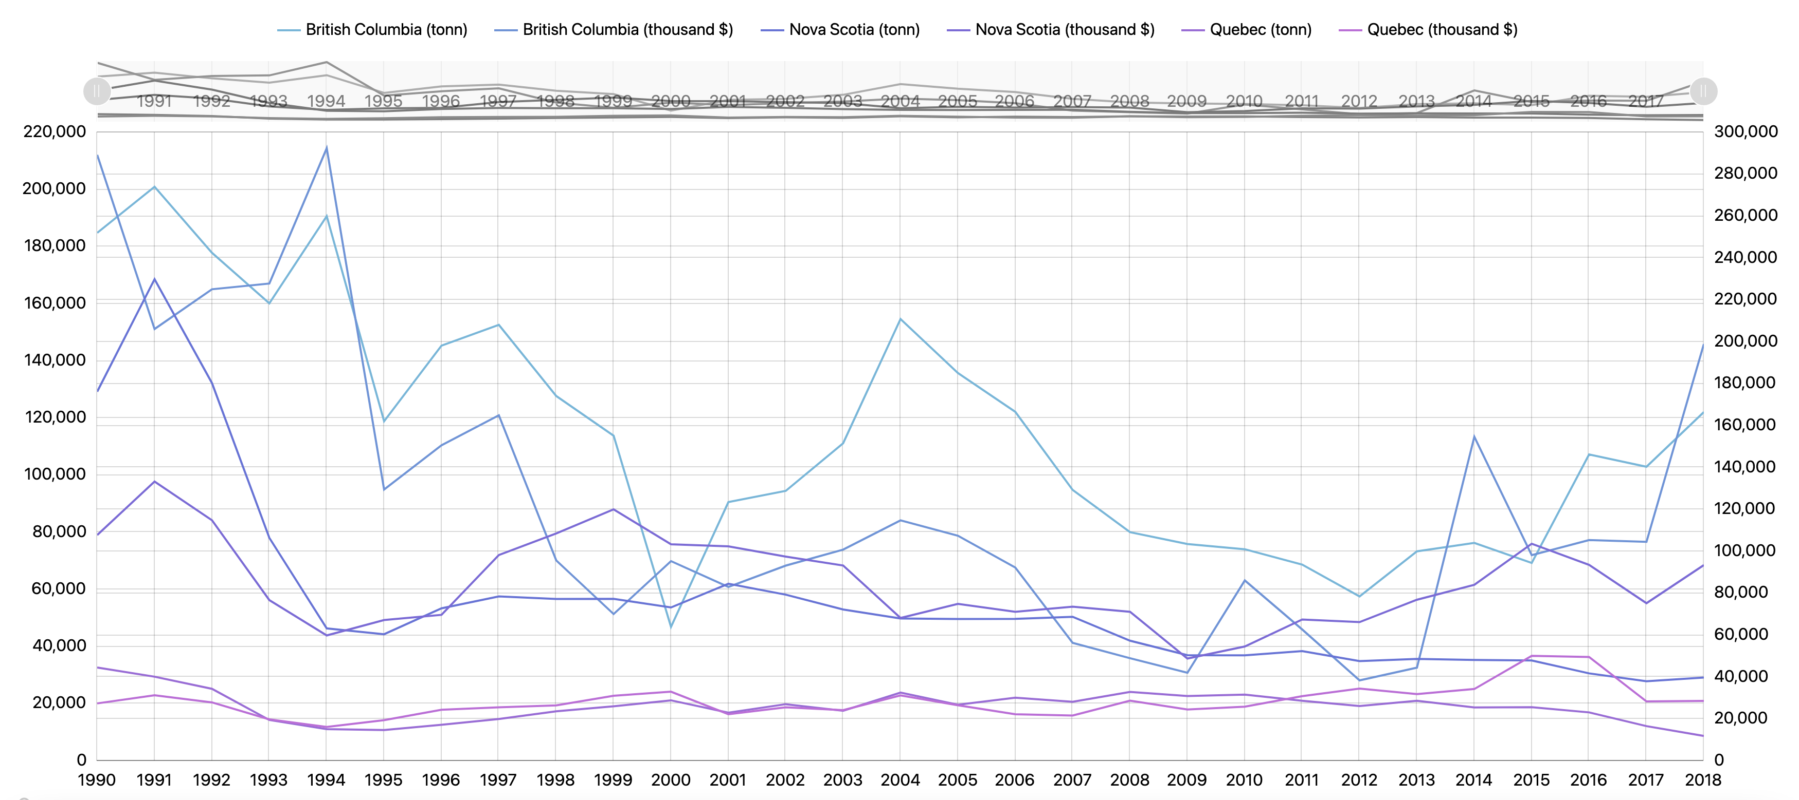
Task 1. Exploring Relationships for Fish Amount and Price

Slide 29
Task 2. Paired Time Series for Fish Amount and Price
The second chart is a scatter plot on which the x-axis is price and the y-axis shows quantities of particular fish types and provinces (picture is below). Bullet points and labels represent years. This visualization helps users to clearly see the correlation between price and quantities throughout the selected years. The proposed graph presents the ability to analyze and compare data efficiently by visualizing multiple values simultaneously. The example (Figure 4.3.2) below showcases the yearly trend of the quantity of shrimp per province compared to its value on the market. The axes show the quantity and value range, and the points represent the year per which the statistic was applicable.
The chart allows us to quickly understand the trend over the years and build analysis on the selected fishery market. By using previously discussed filters, the chart could be expanded to show more than one type of fish. The trends presented in Figure 4.3.2., show how the market was affected through the flow of time. For example, it is easy to notice the relatively steady and proportional growth of the quantity of shrimp in the market and its value from 1990 to 1994. However, the year 1995 has been significantly different in the rise of value compared to almost the same amount of shrimp being available at the market. That could be explained by some other events such as inflation of the currency or the increase of some other type of fish in the province.

Slide 30
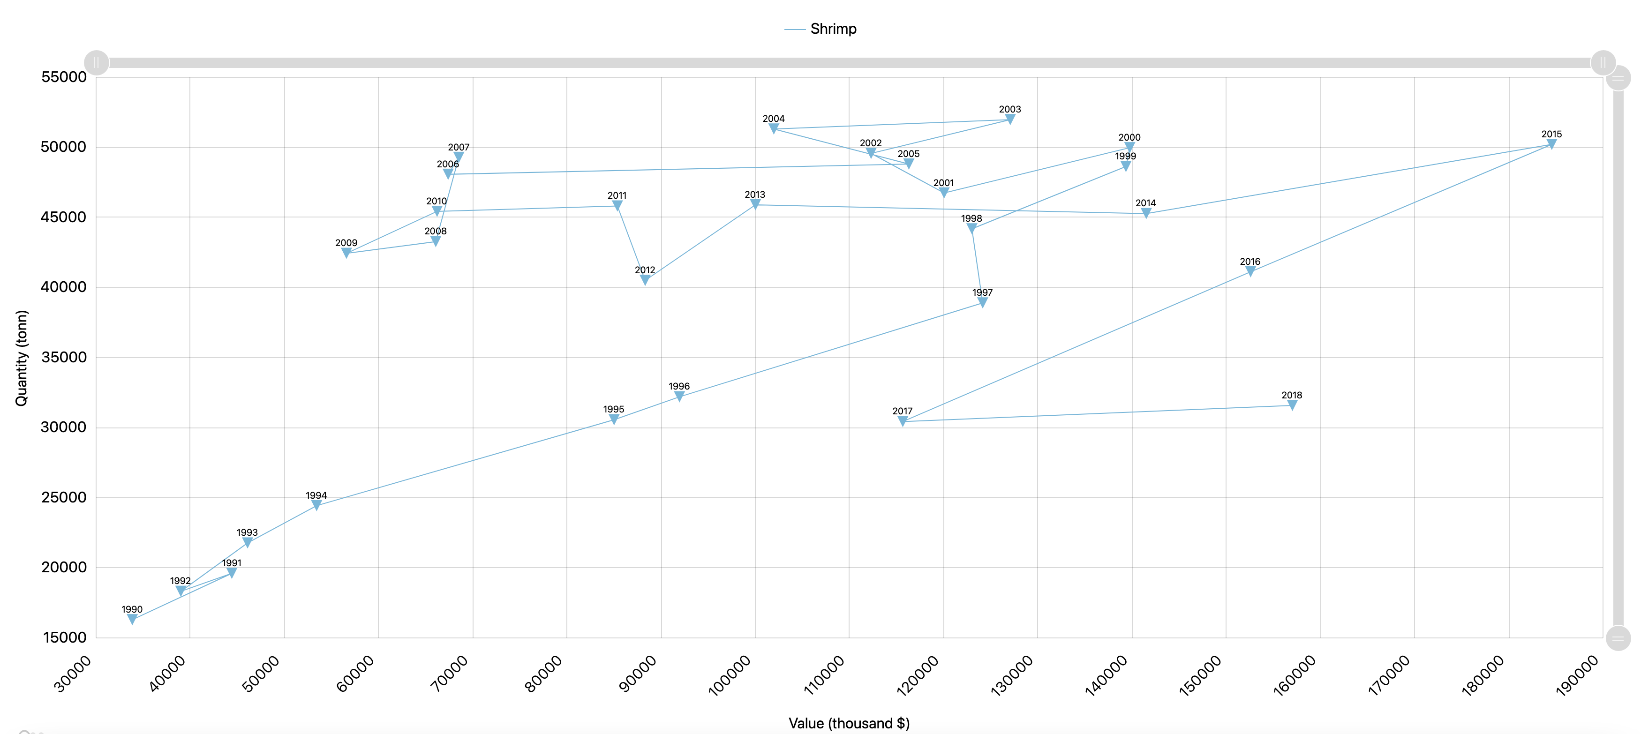
Task 2. Paired Time Series for Fish Amount and Price

Slide 31
Task 3. Identifying Top Fish Species by Catch Amount or Price
The summary charts below (Figure 4.3.3) allow identifying the top fish species by catch amount or value (price) per the selected year. This type of visualization enables a quick and clear understanding of the top fish species in the selected category. The summary information helps compare the data for different years. Therefore, it is important to present the data clearly without going into additional details.
There is also a grouping for fish types that have a small percentage of catch or value comparing to the others which is an improvement (for more than 20 legends, pie charts usually look overcrowded and not readable).
To make the chart user-friendly and structured, the number of legends is adapted depending on the top values per the selected year. FishPlots would sort and group the value ($) or catch quantities (tons) of fish types and assign the applicable percentage per type. The top fish types are separated into their own sections, and the rest is grouped into the category “other”. This solves a well-known problem of having too many unnecessary labels (legends). The chart also allows to expand the “Other” category and drill down to see more details for the fish types which are the “outliers” in the dataset.

Slide 32
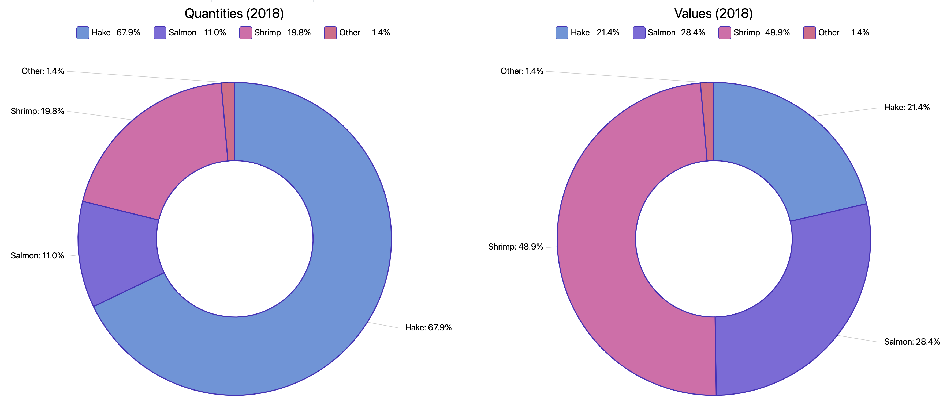
Task 3. Identifying Top Fish Species by Catch Amount or Price

Slide 33
Task 4. Consequent Years Fishery Data Comparison
The main goal of the following visualization is to provide the ability to compare and analyze the data between the selected years quickly and easily. The Chart below (Figure 4.3.4) is an improvement of the standard bar chart called a categorized bar chart. This kind of data presentation is particularly useful for determining trends for the current and previous year. For fishery management it is important to know if, for example, new policies and laws or fishing quotas are working into the intended direction. Years 1990 and 2018 were chosen to better emphasize how the charts’ setup assists in quickly identifying trends.
As mentioned before, the proposed chart is created to compare the data between the two years easy to analyze and review. The space on the x-axis is used to include both of the values that are important for the industry: quantity and price. The y-axis represents the type of fish that was added to the chart for the review. The chart itself serves as a great visual and data centre that could allow the industry professionals to improve the decision-making processes or assist in the further planning of the fishery industry per type. In the provided example, we notice the drastic change in the Cod quantity and price. Both levels have dropped significantly through the decade, highlighting that Cod is no longer a highly available or valuable fish type at the market. Thus, the presented visualization type of data could play an essential role in providing a quick and easy-to-use chart to compare the data trends year by year.

Slide 34
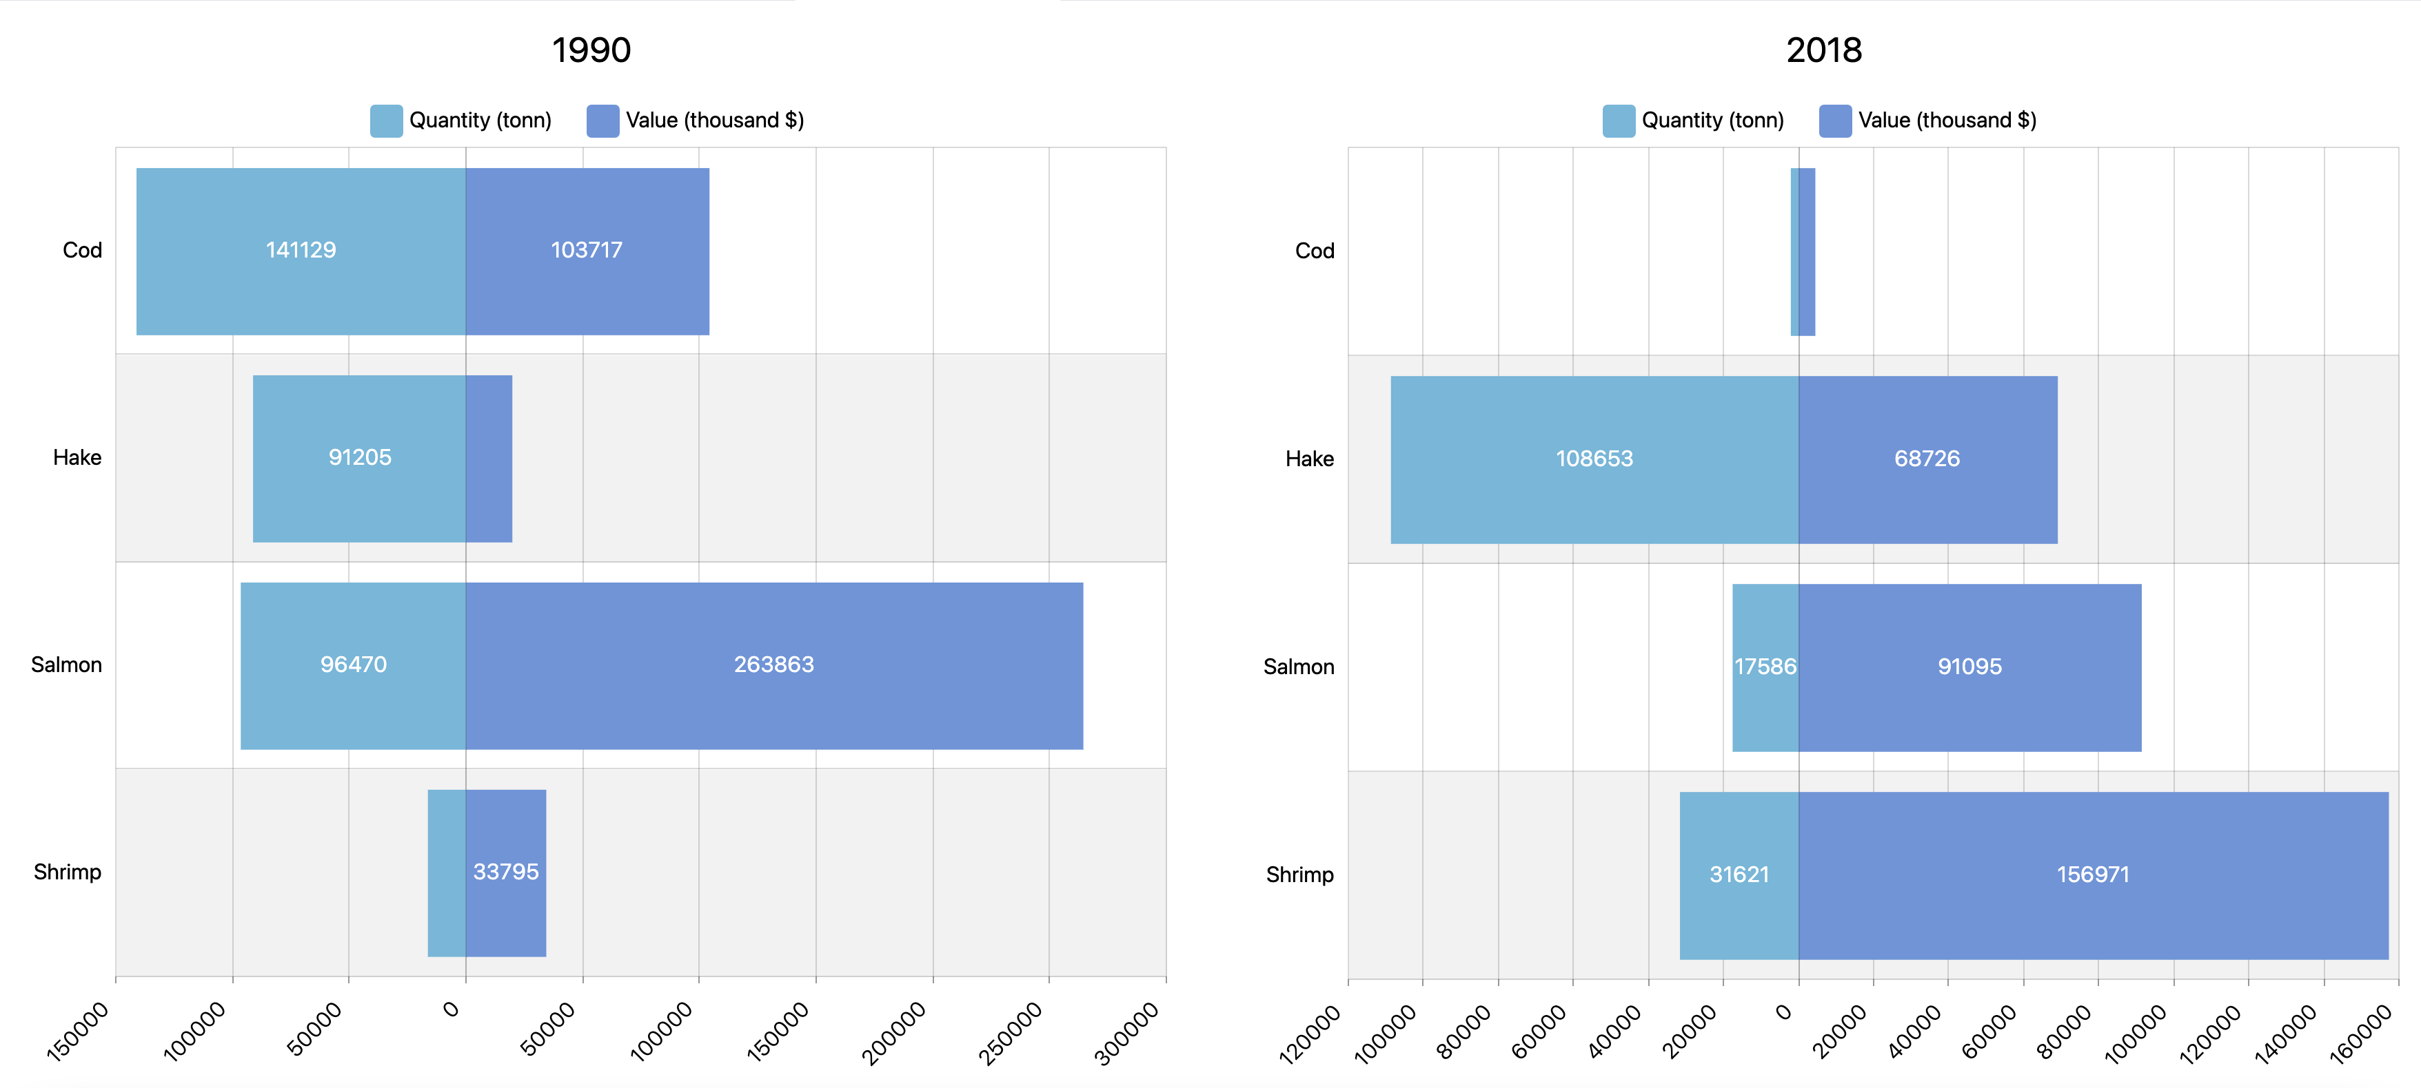
Task 4. Consequent Years Fishery Data Comparison

Slide 35
Conclusions and Future Work
The design and implementation of FishPlots was undertaken according to the marine industry's needs. Specifically, this project reflects fishery management requirements for visuals in reports as presented in chapters 2 and 3. After reviewing existing visualizations for various fields, the report discusses the pros and cons of selecting one or another visualization method. Chapter 3 gave us an understanding on why visualizations for fisheries are important and how exactly people use existing tools and reports. As a result of our investigations, we implemented four different visualizations for fishery management based on DFO data sources. These charts were designed as improvements to the reports discussed in previous sections. Improvements to the developed visualizations will be summarized shortly. Given that visualizations are made suitable for web hosting, they can be uploaded to a remote server and users can access them using a browser without any additional software installed on their workstations.
Task 1 helps the user to explore relations between fish values and amounts. Improvements can be listed like this: the ability to select/deselect fish types/provinces, zoom feature which allows users to see data for smaller date range without a need to re-render visualization. Task 2 is a scatter plot, which combines 3 dimensions: value, amount, year. Data points are connected by lines which gives the user a historical overview of fishery data. Using this chart, the user can see trends of the value/amount ratio for different fish types. Pie charts in task 3 show data like they are used for report summary. The grouping feature allows users to reduce the number of legends which is useful specifically for pie charts (it’s hard to read visuals with more than 5-6 legends presented). And last but not the least, visualization for task 4 is allows comparison of summary data for any two selected years. These kinds of bar charts are used by fishery management to see trends between consecutive years. Showing different dimensions on the same axis allows reducing clutter from creating duplicate bar charts for comparing price and quantity separately and makes the report chart easier to read for the end-user. After implementing the visualizations for this project, there are still some improvements that could be applied to the FishPlots that can make it more reliable for the user.
Firstly, bringing more data sources to explore wider range of marine issues. With this approach, scientists or management people can combine or compare charts built from different sources. This future improvement could provide broader and more unbiased knowledge of the problem the user is trying to investigate.
Secondly, saving visualization state (serialization) would be nice to have as an additional feature. In this case, users can share and discuss their visualizations without a need to re-apply settings. This improvement can be developed in several ways. For example, saving the state of particular visualization in JSON file on the user's machine. Next time when users want to use FishPlots, they can just locate the file, upload it into the tool and there will be visuals in a saved state displayed on a screen. Another approach is serializing the state of visualization into a string (URL link). Then it can be used by another user who has access to the link. FishPlots will parse that URL and automatically apply all necessary settings.
And finally, users will most likely want to have synchronization of new data from sources. This improvement requires communication with data providers, implementing external APIs from their side. It is out of the scope for this visualization project but can be implemented using the REST [23] approach.

